Slide 1
SAGA Transactions
Microservices Architecture

Slide 2
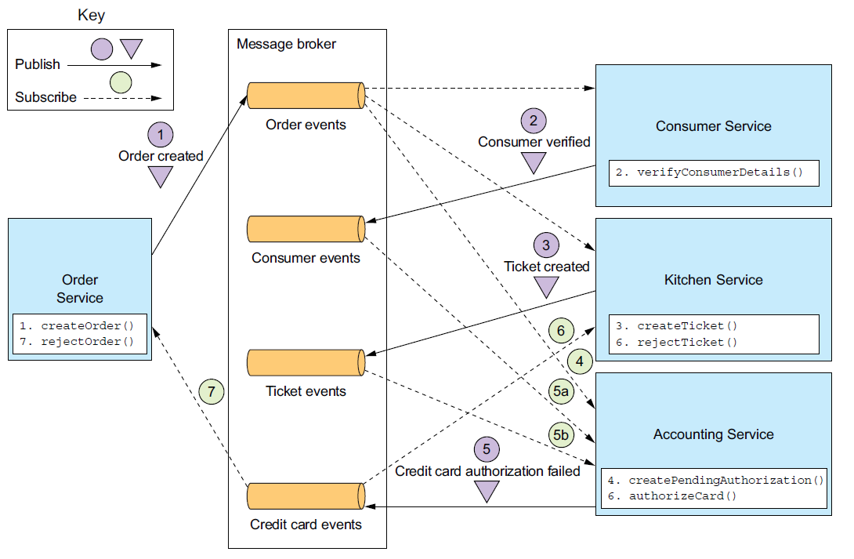
Choreograph

Slide 3
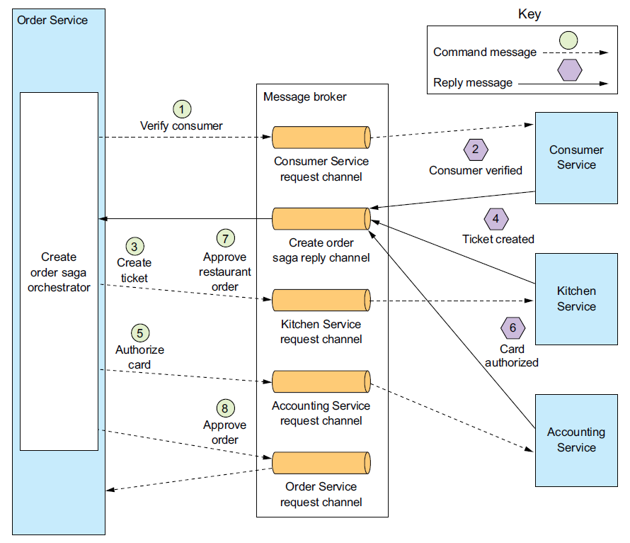
Orchestration

